Slide 1
CMS Connectathon 2024
The Centers for Medicare & Medicaid Services (CMS) and HL7 International are proud to bring stakeholders together again virtually for the 5th annual CMS HL7 FHIR Connectathon.
This is a free, virtual event being held July 16th through the 18th
Connectathon Page: https://confluence.hl7.org/display/FHIR/CMS+2024+-+07+FHIR+Connectathon+5
Clinical Quality Improvement Track Page: https://confluence.hl7.org/display/FHIR/2024+-+07+Clinical+Quality+Improvement
Event registration link: https://www.hl7.org/events/cms/

Slide 2
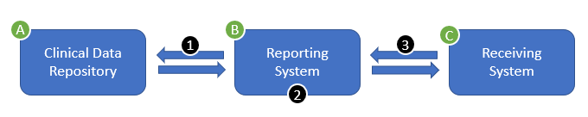
Focus Scenarios
Gather: The Reporting System queries the Clinical Data Repository for the data required to evaluate the measure.
Evaluate: The Reporting System evaluates the quality measure, producing a MeasureReport resource.
Report: The Reporting System posts the completed MeasureReport to the Receiving System

Slide 3
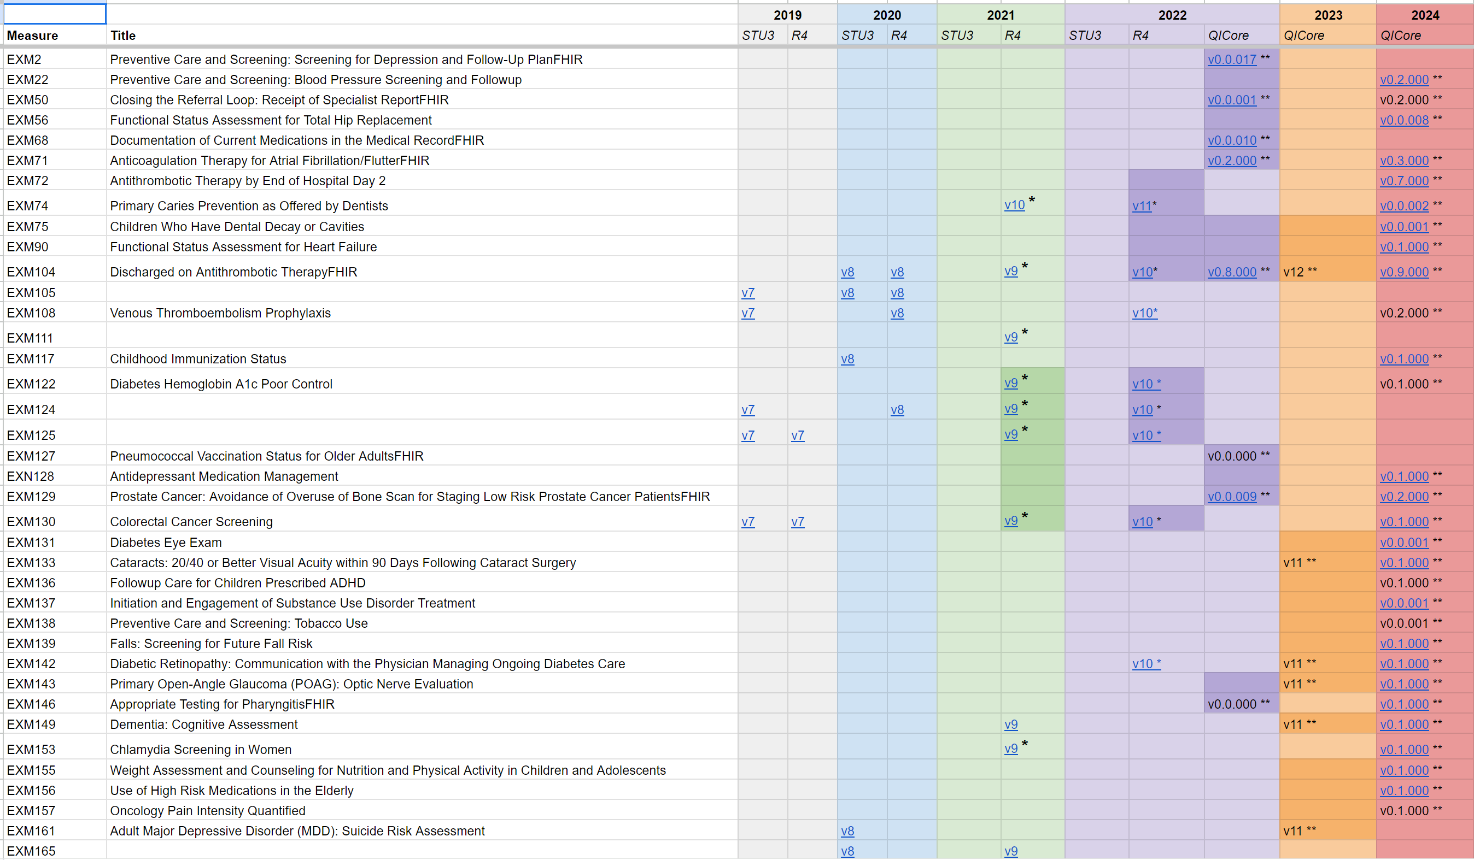
Measure Testing Content
Measure Content – Google Drive Link

Slide 4
Call For Participation
Participants to test, especially in the role of Clinical Data Repository (USCore 3.1.1 API)
Participants interested in demonstrating
Email fhir@icf.com if you are planning to bring implementations, if you would like to demo, and/or have any other questions or comments

